Slide 1
Dynamic Programming (DP)
Presentasi Template oleh Komunitas CP ITB

Slide 2
What Will We Discuss today?
What is DP?
Dynamic Programming Concept
Example Problem
Classical Dynamic Programming
Conclusion

Slide 3
Dynamic Programming
Wikipedia definition: “a method for solving complex problems by breaking them down into simpler subproblems”.
Another definition : “DP is bruteforce with some optimation”.
DP is wide topic, so we need to practise, practise and practise to be master in this topic.

Slide 4
DP Concept
DP is problem solving technique that involve decision making by utilizing information from resolving the same but smaller sub-problems.
Problem can be solved with DP if and only if the optimal solution can be determined from the optimal solution sub-problems.

Slide 5
DP Concept
There are two ways to implements DP:
Top-Down : Recursive. Save the value that we have found (memoization)
Bottom-Up : Iterative. Count the value from smaller case to larger case.

Slide 6
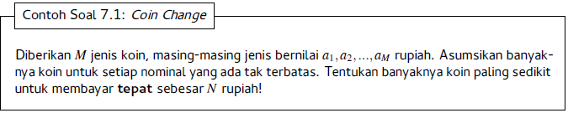
Example DP (Coin Change)

Slide 7
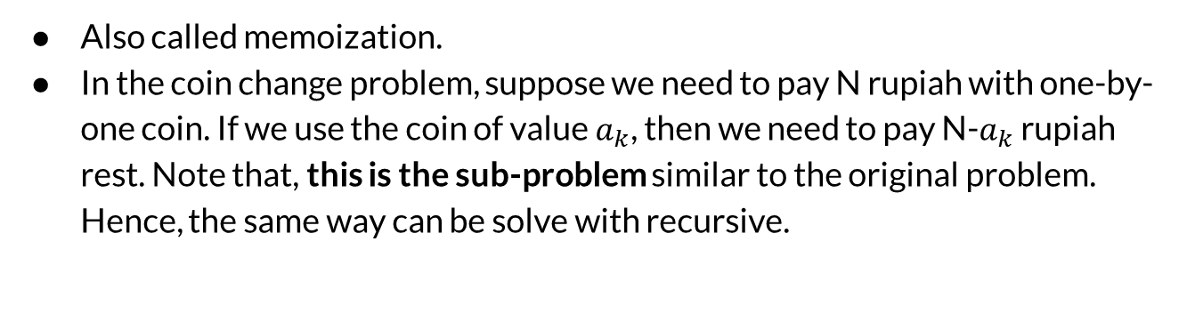
Top-Down Method
Also called memoization.
In the coin change problem, suppose we need to pay N rupiah with one-by-one coin. If we use the coin of value $a_{k}$, then we need to pay N-$a_{k}$ rupiah rest. Note that, this is the sub-problem similar to the original problem. Hence, the same way can be solve with recursive.

Slide 8
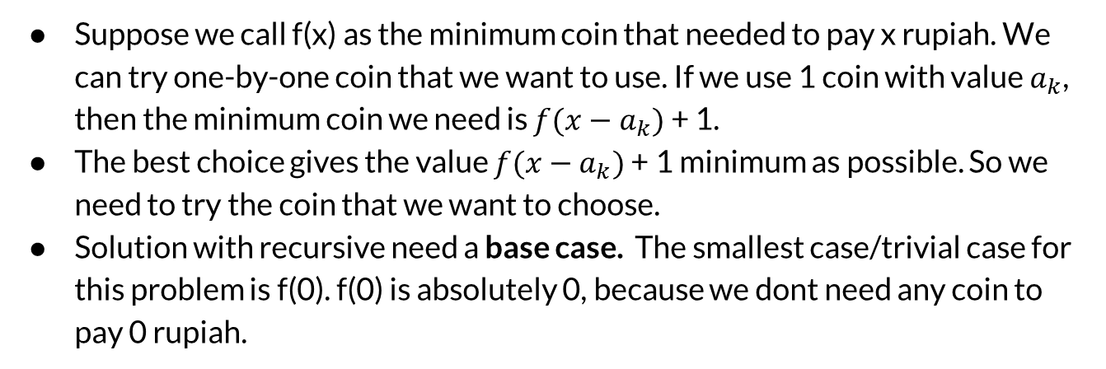
Recursive Solution
Suppose we call f(x) as the minimum coin that needed to pay x rupiah. We can try one-by-one coin that we want to use. If we use 1 coin with value $a_{k}$, then the minimum coin we need is $f(x−a_{k})$ + 1.
The best choice gives the value $f(x−a_{k})$ + 1 minimum as possible. So we need to try the coin that we want to choose.
Solution with recursive need a base case. The smallest case/trivial case for this problem is f(0). f(0) is absolutely 0, because we dont need any coin to pay 0 rupiah.

Slide 9
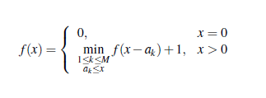
Recursive Solution
So the mathematical relationship for solving this problem is:

Slide 10
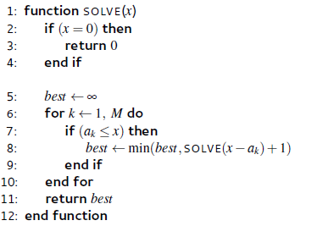
Recursive Solution
If we write the solution in pseudocode, then it can be written as:

Slide 11
Instance Problem
Suppose We have coins with value 1, 6, and 10 rupiah.
We can use a coin infinitely.
What is the minimum number of coin to pay 12 rupiah?

Slide 12
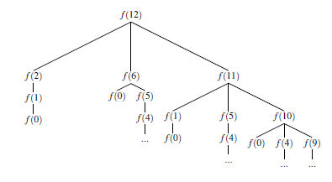
Solution to Instance Problem
If we use the function that we have discussed before, then the problem can be draw as a recursive tree function like this;

Slide 13
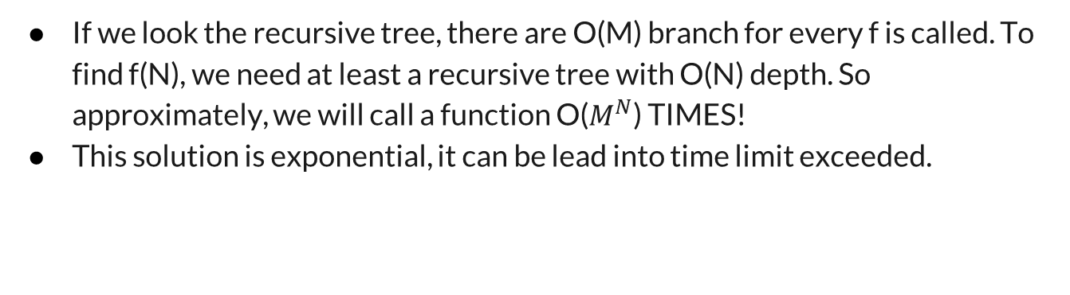
BUT LOOK!
If we look the recursive tree, there are O(M) branch for every f is called. To find f(N), we need at least a recursive tree with O(N) depth. So approximately, we will call a function O($M^{N}$) TIMES!
This solution is exponential, it can be lead into time limit exceeded.

Slide 14
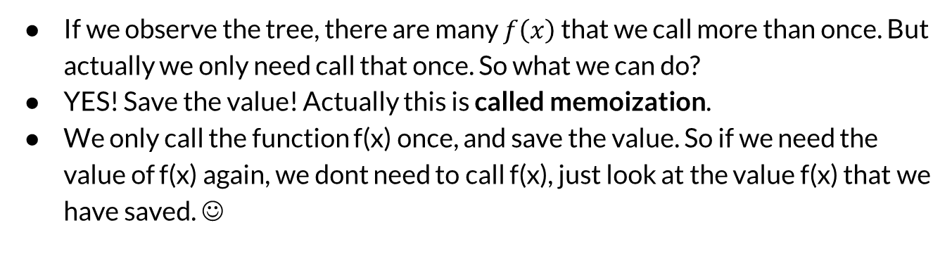
Optimation With Memoization
If we observe the tree, there are many $f\left(x\right)$ that we call more than once. But actually we only need call that once. So what we can do?
YES! Save the value! Actually this is called memoization.
We only call the function f(x) once, and save the value. So if we need the value of f(x) again, we dont need to call f(x), just look at the value f(x) that we have saved. ☺

Slide 15
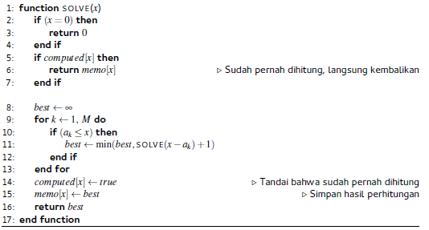
Recursive Solution DP

Slide 16
Complexity
Assume that for counting the value f(x), we need O(M) iteration, so for counting the value x for all x, we need O(NM) operations. This way is of course faster than the previous solution.

Slide 17
Bottom-Up Method
In bottom-up solution, we solve the problem from the smaller case until it comes to bigger case. If we know the base case from recursive, then in bottom-up, this value is used for find the value of a bigger case.
Bottom-up method is often called as “Table filling DP”.

Slide 18
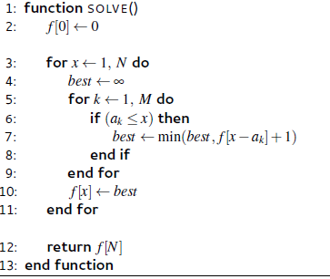
Bottom-Up Solution

Slide 19
Description
Actually the complexity solution of bottom-up method is the same with top-down method. O(NM).
These solution actually is the same algorithm only have different in direction of answer search.

Slide 20
Some Classic DP
There are some classic problems in competitive programming that can be done with DP.
They are:
Range sum
0/1 Knapsack Problem
LCS Problem

Slide 21
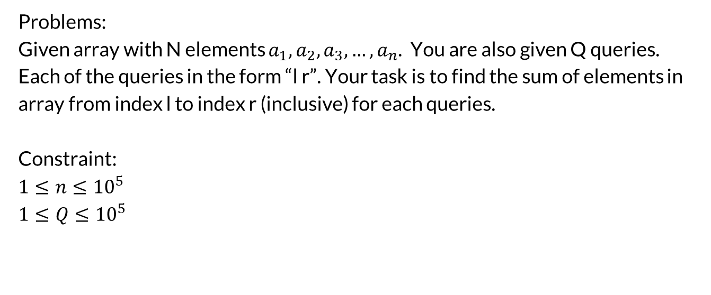
Range Sum
Problems:
Given array with N elements $a_{1}, a_{2},a_{3},…, a_{n}$. You are also given Q queries. Each of the queries in the form “l r”. Your task is to find the sum of elements in array from index l to index r (inclusive) for each queries.
Constraint:
$$1≤n≤{10}^{5}$$
$$1≤Q≤{10}^{5}$$

Slide 22
How to solve?
Bruteforce?
Of course it will be TLE.
Greedy?
Of course not!
DP!
Yeahh it’s DP! But how?

Slide 23
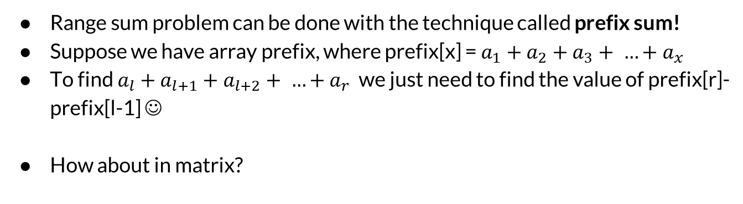
Solution
Range sum problem can be done with the technique called prefix sum!
Suppose we have array prefix, where prefix[x] = $a_{1}+a_{2}+a_{3}+ …+a_{x}$
To find $a_{l}+a_{l+1}+a_{l+2}+ …+a_{r}$ we just need to find the value of prefix[r]-prefix[l-1] ☺
How about in matrix?

Slide 24
0/1 Knapsack
Given n items, each with its own value Vi and weight Wi, ∀i ∈ [0..n-1], and a maximum knapsack size S, compute the maximum value of the items that we can carry, if we can either ignore or take a particular item (hence the term 0-1 for ignore/take).

Slide 25
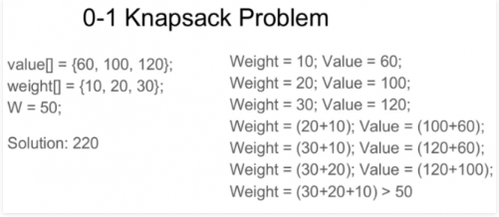
Example

Slide 26
Solution
This problem can be resume as “we need to maximize the value of the item we take but not exceed the knapsack”.
So the problems will be limited by capacity of knapsack, and value of the item. This two limited will be our state for this problem.
Furthermore, we can make a function f(pos, cap) denote the maximum value of the object we can take if we only need item indexed from 1 to pos with maximum capacity cap.

Slide 27
Solution
After we define the function, we need to find the base case / trivial case.
The base case: if pos = 0, then there is no item we can take, so of course the value f(0, cap) = 0.
After we know the base case, now we need the relationship among the subproblems.

Slide 28
Solution
Suppose we are in the item index-pos
We have two possibilities:
We take the item with index-pos:
we must certain that the knapsack capacity now is greater than or equal the weight of this item. If yes, then the problem will decompose into f(pos-1, cap-weight[pos]) + value[pos].
2. We skip the item with index-pos:
if we skip this item, then the problem will decompose into f(pos-1, cap).
Among these two possibilities, we take the maximum value.

Slide 29
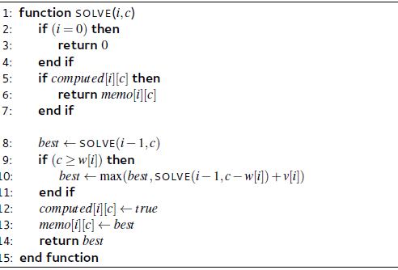
Solution
Two find the solution we call the function SOLVE(N,S).

Slide 30
Longest Common Subsequence (LCS)
Given two strings A and B. The length of these two strings are not necessary the same. How long is the longest string that is the subsequence of A and B?
Subsequence of a string is another string that is formed by deleting zero or more character from the original string without change the position. For example, “irf”, “ir”, “rfn” is a subsequence from string “irfan” while “na”, “fr”, and “ar” is not.
For example,
A = “ajaib”
B = “badai”
LCS from A and B is “aai” with the length 3.

Slide 31
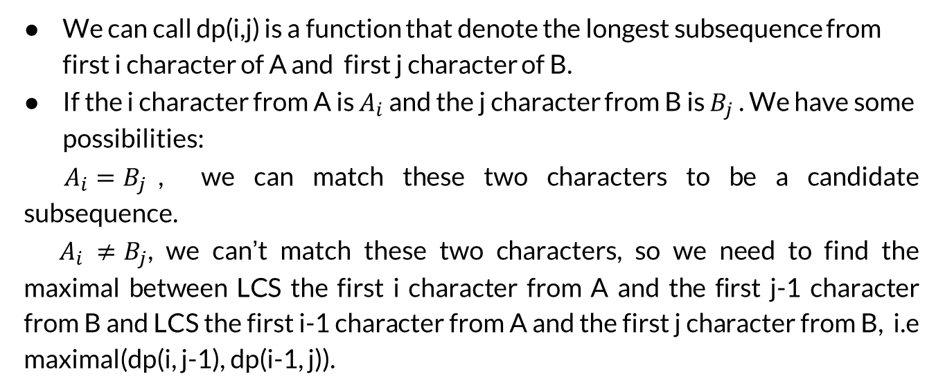
Solution
We can call dp(i,j) is a function that denote the longest subsequence from first i character of A and first j character of B.
If the i character from A is $A_{i}$ and the j character from B is $B_{j}$ . We have some possibilities:
$A_{i}=B_{j}$, we can match these two characters to be a candidate subsequence.
$A_{i} ≠B_{j}$, we can’t match these two characters, so we need to find the maximal between LCS the first i character from A and the first j-1 character from B and LCS the first i-1 character from A and the first j character from B, i.e maximal(dp(i, j-1), dp(i-1, j)).

Slide 32
Solution
What is the base case?
The base for this problem is when there is no character left in some string. This value will be 0. (i.e dp(0,j) = 0, dp(i, 0) = 0)

Slide 33

Solution
So, the solution will be in the form

Slide 34
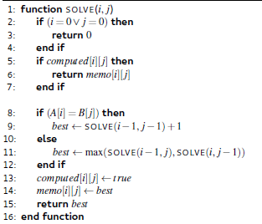
Solution

Slide 35
Conclusion
Steps for solving the DP problems:
Define the state of the problems and the subproblem it self.
Write down what is the relationship between the subproblems.
Recognize and solve the best case.

Slide 36
Exercise
Problem: given 𝑛, find the number of different ways to write 𝑛as the sum of 1, 3, 4
Example: for n = 5, the answer is 6
5 = 1 + 1 + 1 + 1 + 1
5 = 1 + 1 + 3
5 = 1 + 3 + 1
5 = 3 + 1 + 1
5 = 1+4
5 = 4+1

Slide 37
Exercise
SPOJ RPLB

